Slide 1

Pattern Classification
All materials in these slides were taken from
Pattern Classification (2nd ed) by R. O. Duda, P. E. Hart and D. G. Stork, John Wiley & Sons, 2000 with the permission of the authors and the publisher
Pattern Classification Chapter 2(Part 3)

Slide 2
Chapter 2 (part 3)
Bayesian Decision Theory (Sections 2-6,2-9)
Discriminant Functions for the Normal
Density
Bayes Decision Theory – Discrete Features
Pattern Classification Chapter 2(Part 3)

Slide 3

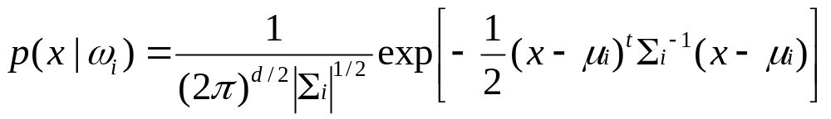
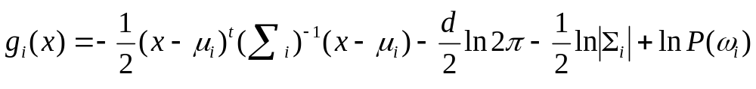
2.6 Discriminant Functions for the Normal Density
We saw that the minimum error-rate classification can be achieved by the discriminant function
g_{i}(x) = ln p(x | ω_{i}) + ln P(ω_{i})
Case of multivariate normal
Pattern Classification Chapter 2(Part 3)

Slide 4
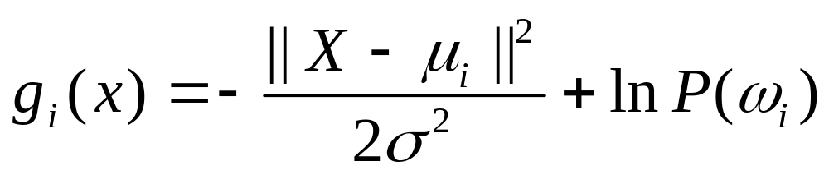




Case Σ_{i} = σ².I (I stands for the identity matrix)
Pattern Classification Chapter 2(Part 3)

Slide 5
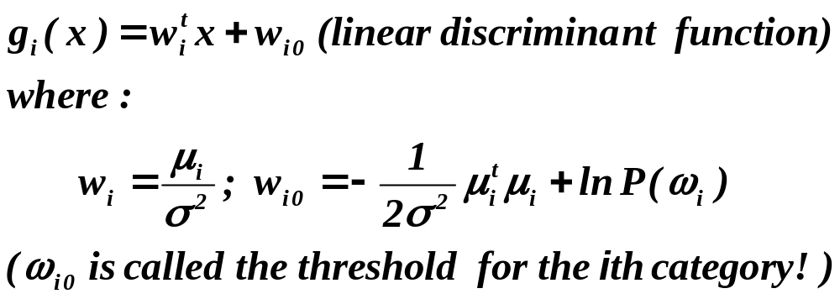

Case Σ_{i} = σ².I (I stands for the identity matrix)
Pattern Classification Chapter 2(Part 3)

Slide 6

  A classifier that uses linear discriminant functions is called “a linear machine”
  The decision surfaces for a linear machine are pieces of hyperplanes defined by:
g_{i}(x) = g_{j}(x)
Pattern Classification Chapter 2(Part 3)

Slide 7
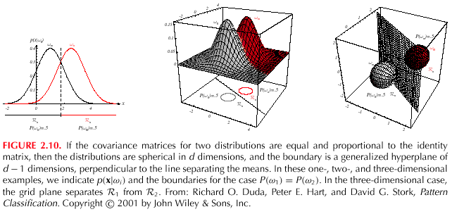


Pattern Classification Chapter 2(Part 3)

Slide 8
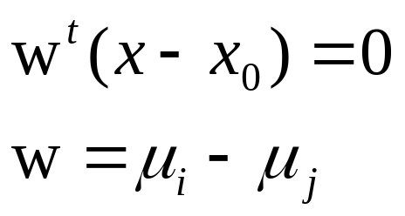
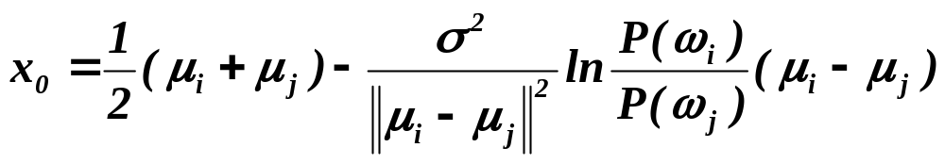
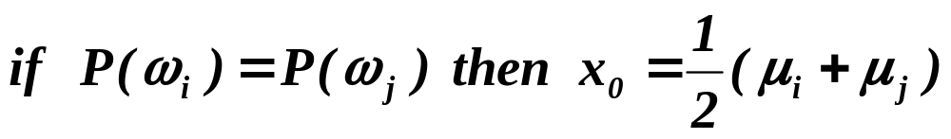
  The hyperplane separating R_{i} and R_{j}
  is always orthogonal to the line linking the means!
g_{i}(x) = g_{j}(x)
Pattern Classification Chapter 2(Part 3)

Slide 9
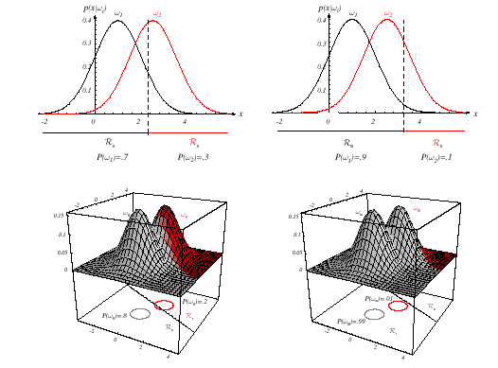
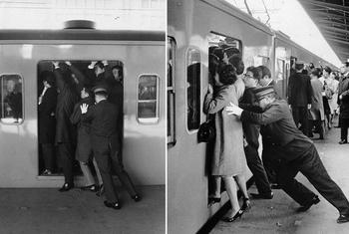
Pattern Classification Chapter 2(Part 3)

Slide 10
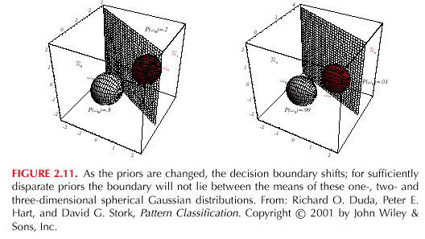

Pattern Classification Chapter 2(Part 3)

Slide 11

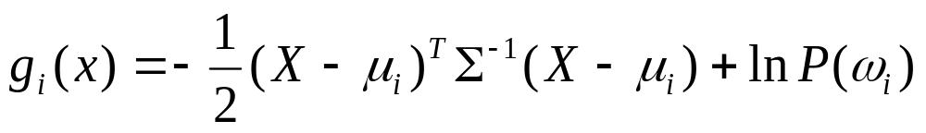
Case Σ_{i} = Σ (covariance of all classes are identical but arbitrary!)
Pattern Classification Chapter 2(Part 3)

Slide 12
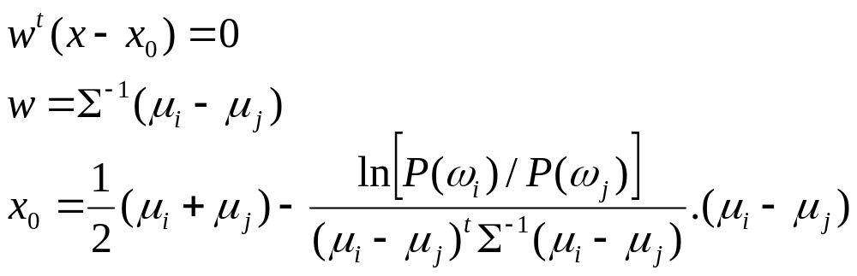
Case Σ_{i} = Σ (covariance of all classes are identical but arbitrary!)
  Hyperplane separating R_{i} and R_{j}
  (the hyperplane separating R_{i} and R_{j} is generally not orthogonal to the line between the means!)
Pattern Classification Chapter 2(Part 3)

Slide 13
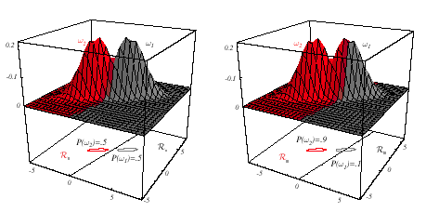
Pattern Classification Chapter 2(Part 3)

Slide 14
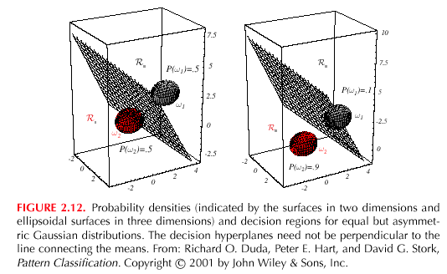

Pattern Classification Chapter 2(Part 3)

Slide 15
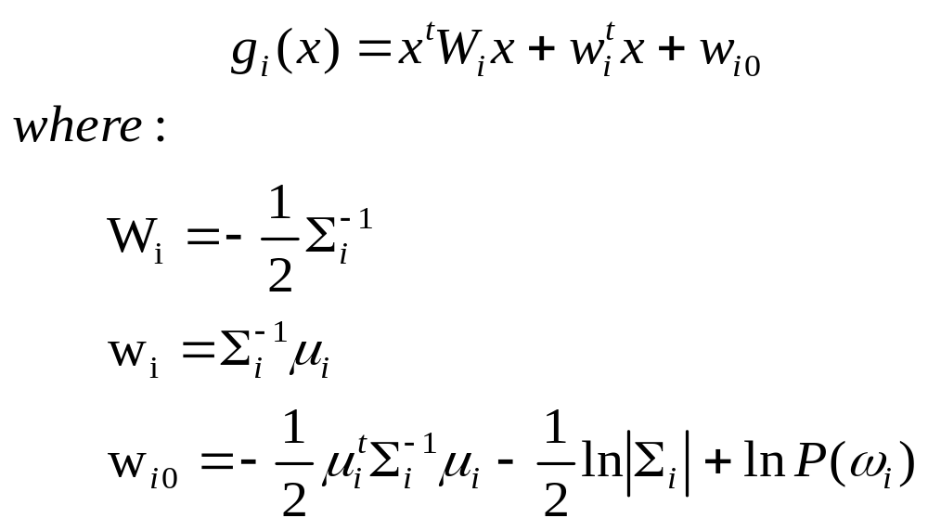


Case Σ_{i} = arbitrary
  The covariance matrices are different for each category
  (Hyperquadrics which are: hyperplanes, pairs
  of hyperplanes, hyperspheres, hyperellipsoids, hyperparaboloids, hyperboloids)
Pattern Classification Chapter 2(Part 3)

Slide 16
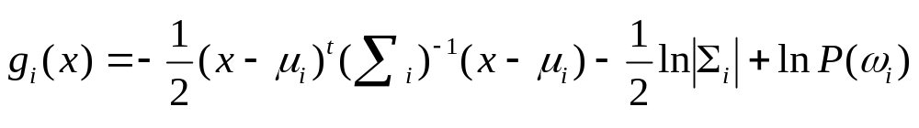
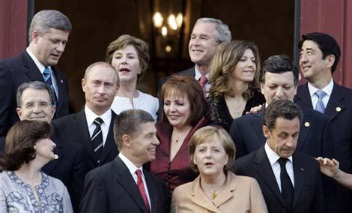
Case Σ_{i} = arbitrary
The covariance matrices are different for each category
Pattern Classification Chapter 2(Part 3)

Slide 17
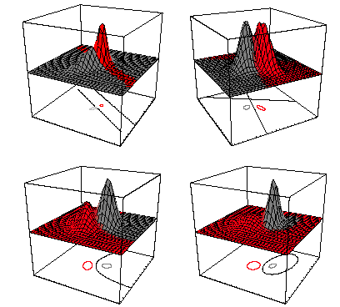


Pattern Classification Chapter 2(Part 3)

Slide 18

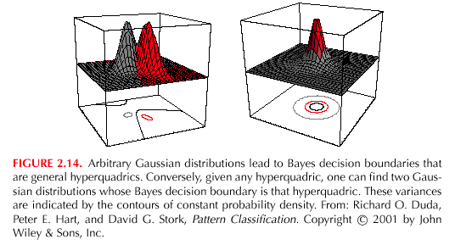

Pattern Classification Chapter 2(Part 3)

Slide 19
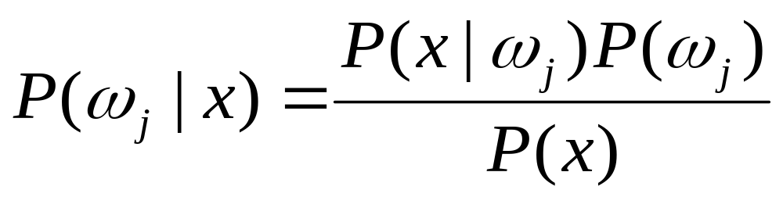
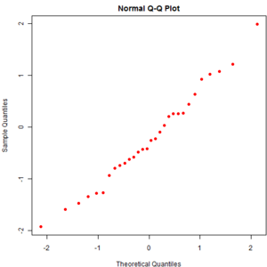
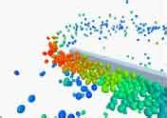

2.9 Bayes Decision Theory – Discrete Features
Components of x are binary or integer valued, x can take only one of m discrete values
v₁, v₂, …, v_{m}
Pattern Classification Chapter 2(Part 3)

Slide 20


It’s hard to evaluate the probability of discrete high-dimensional sample
x=[he and she first went shopping……]
How to evaluate the value of p(x)?
Pattern Classification Chapter 2(Part 3)

Slide 21
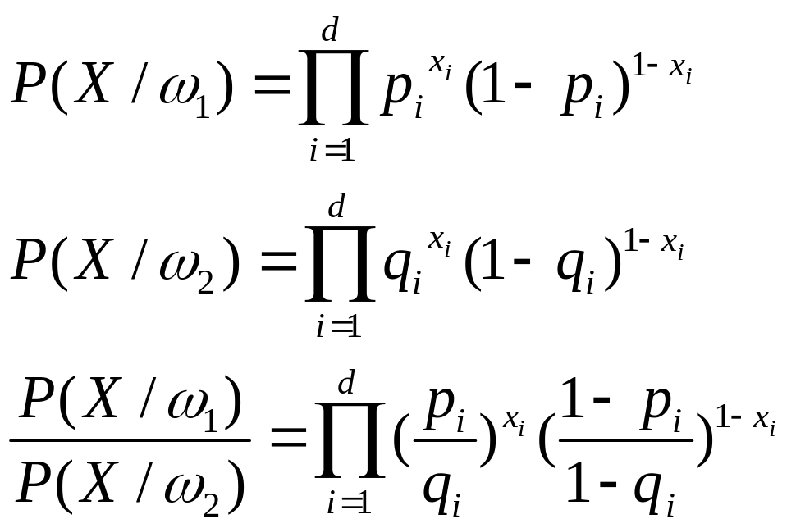

Case of independent binary features in 2 category problem
Let x = [x₁, x₂, …, x_{d} ]^{t} where each x_{i} is either 0 or 1, with probabilities:
p_{i} = P(x_{i} = 1 | ω₁) (P(x_{i} = 0 | ω₁)=1- p_{i})
q_{i} = P(x_{i} = 1 | ω₂) (P(x_{i} = 0 | ω₂)=1- q_{i})
Pattern Classification Chapter 2(Part 3)

Slide 22
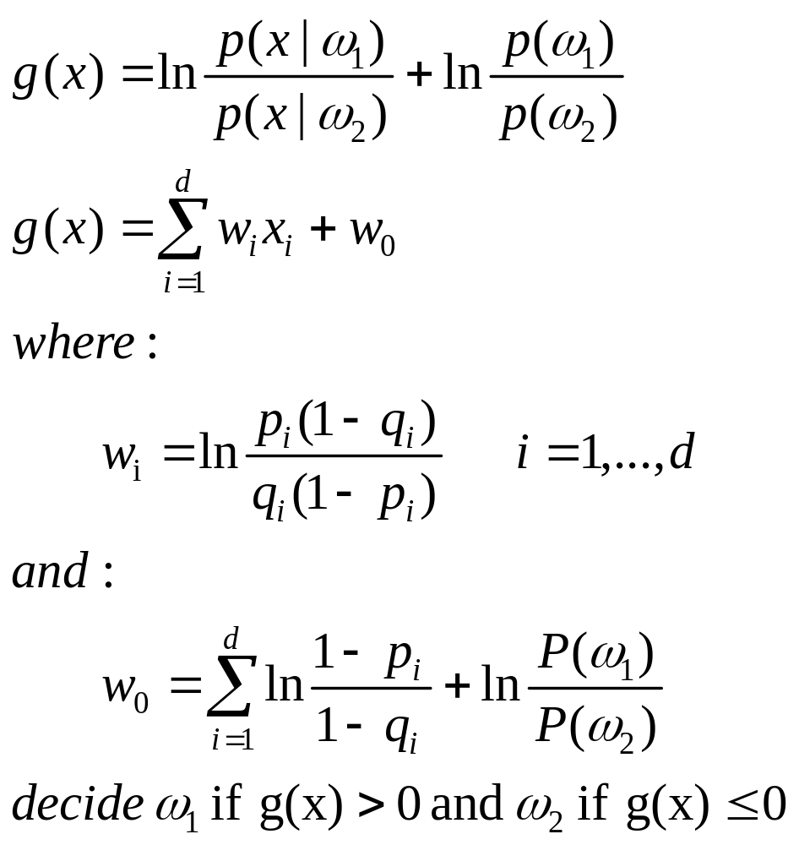


The discriminant function in this case is:
Pattern Classification Chapter 2(Part 3)

Slide 23


Assumption
V=[v₁, v₂, …, v_{m}]
P(v|w_{i})= P(v₁|w_{i})… P(v_{m}|w_{i})
For natural language processing,
v₁, v₂, …, v_{m denote different words}
Pattern Classification Chapter 2(Part 3)

Slide 24
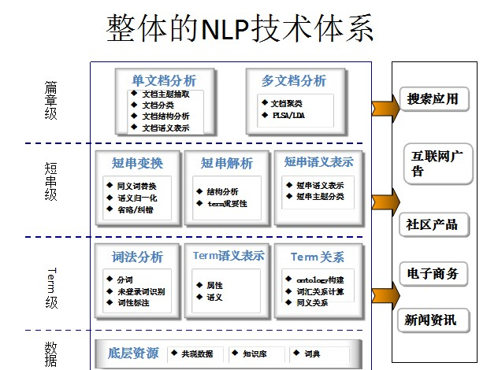
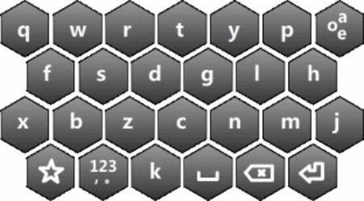

Bayes Decision Theory on discrete features have been widely used in natural language processing, speech recognition, text classification, OCR et al.
Pattern Classification Chapter 2(Part 3)

